Slide 1
Analyzing Open Source Software Ecosystems
Mentors: Dr. Alexey Tregubov, Dr. Jeremy Abramson, Dr. Jim Blythe
Students: Apoorv Dixit, Kai Zheng, Zishen Wei

Slide 2
Motivation & Goal
Vulnerabilities of open-source software
Data breach
Compromised system
Financial loss
Vulnerability assessment is needed
Analyze source code and patch discussions of open-source software
Malware analysis
Topic modeling
Authorship styles
Help protect the health of OSS code and communities

Slide 3
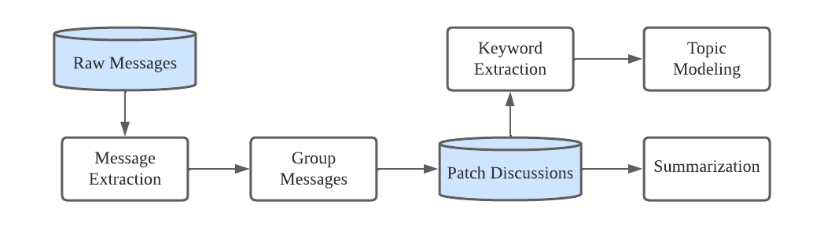
Data & Approach
Data: raw messages from Linux Kernel Mailing List
Extract clean messages on the raw data
Analyze individual messages and patch discussions
Keyword Extraction
Summarization

Slide 4
Email Message Cleaning
Building foundation of the message analysis
Recover and Clean messages from the linux kernel mailing list
Extract the file names in the message
Matching with the corresponding Maintainer Group

Slide 5
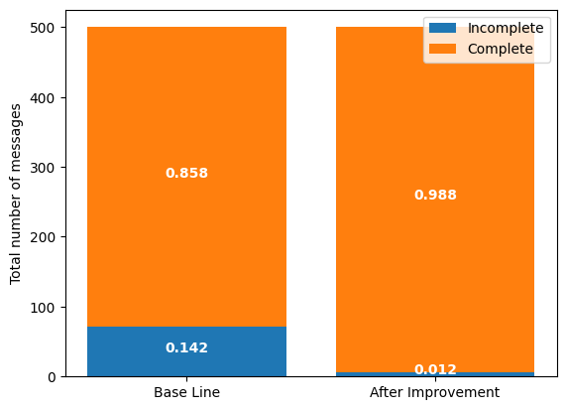
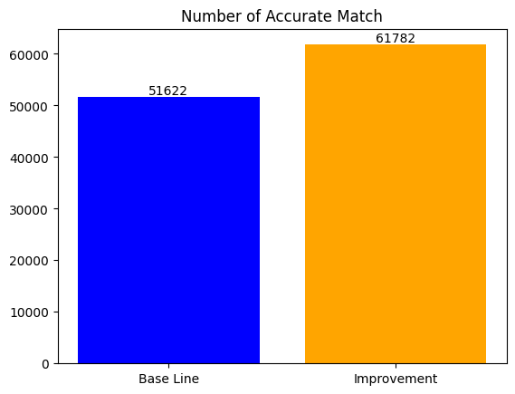
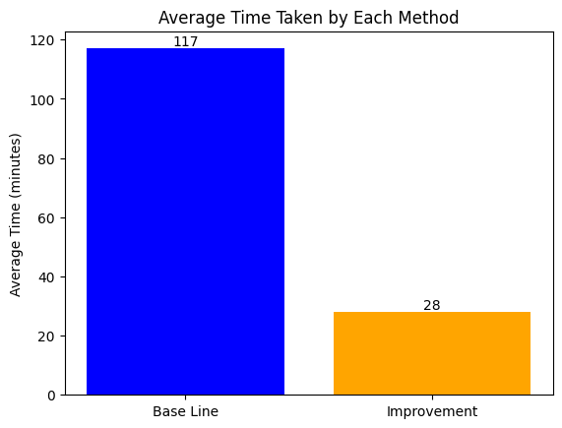
Clean Message improved 13%
Maintainer Group Matching improved 16%
Efficiency improved 76%

Slide 6
Keyword Extraction
Extract keywords from individual messages and patch discussions
Leverage the power of large language model
Hugging face models
GPT
KeyLLM
Evaluation
Compare the results with hand-picked keywords
Calculate the precision, recall and F1 score

Slide 7
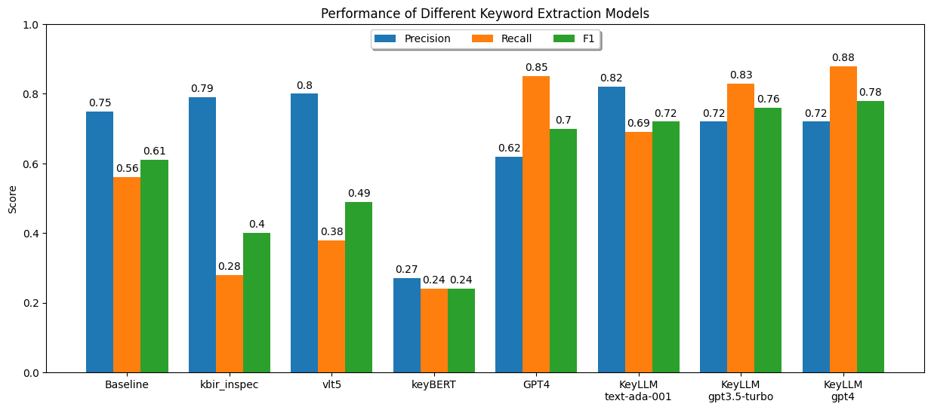
Keyword Extraction - Result
Overall, KeyLLM with GPT4 has the best performance

Slide 8
Text Summarization
Conduct text summarization on OSS commit messages
Leverage the power of large language models
GPT 3.5
GPT 4
LLama 2
Evaluation
Assessed the results using ROUGE metrix
Calculate the precision, recall and F1 score

Slide 9
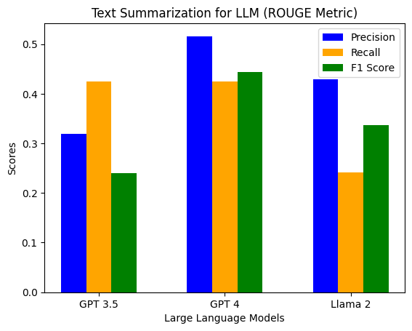
Text Summarization - Result
Overall, GPT4 has the best performance

Slide 10
Conclusion and future work
We completed:
clean messages and patch metadata (diff, files, maintainer groups) extraction
message and patch discussion keyword extraction
message and patch discussion summarization
Future work includes:
topic modeling using maintainer groups (WIP).
Website:
https://ckids-datafirst.github.io/2023-fall-software-ecosystems/

